Slide 1

Simulating Outpatient Radiology Imaging Services
By Jean Jimenez
For CUNY SPS Data 604 Final Project
Summer 2024

Slide 2
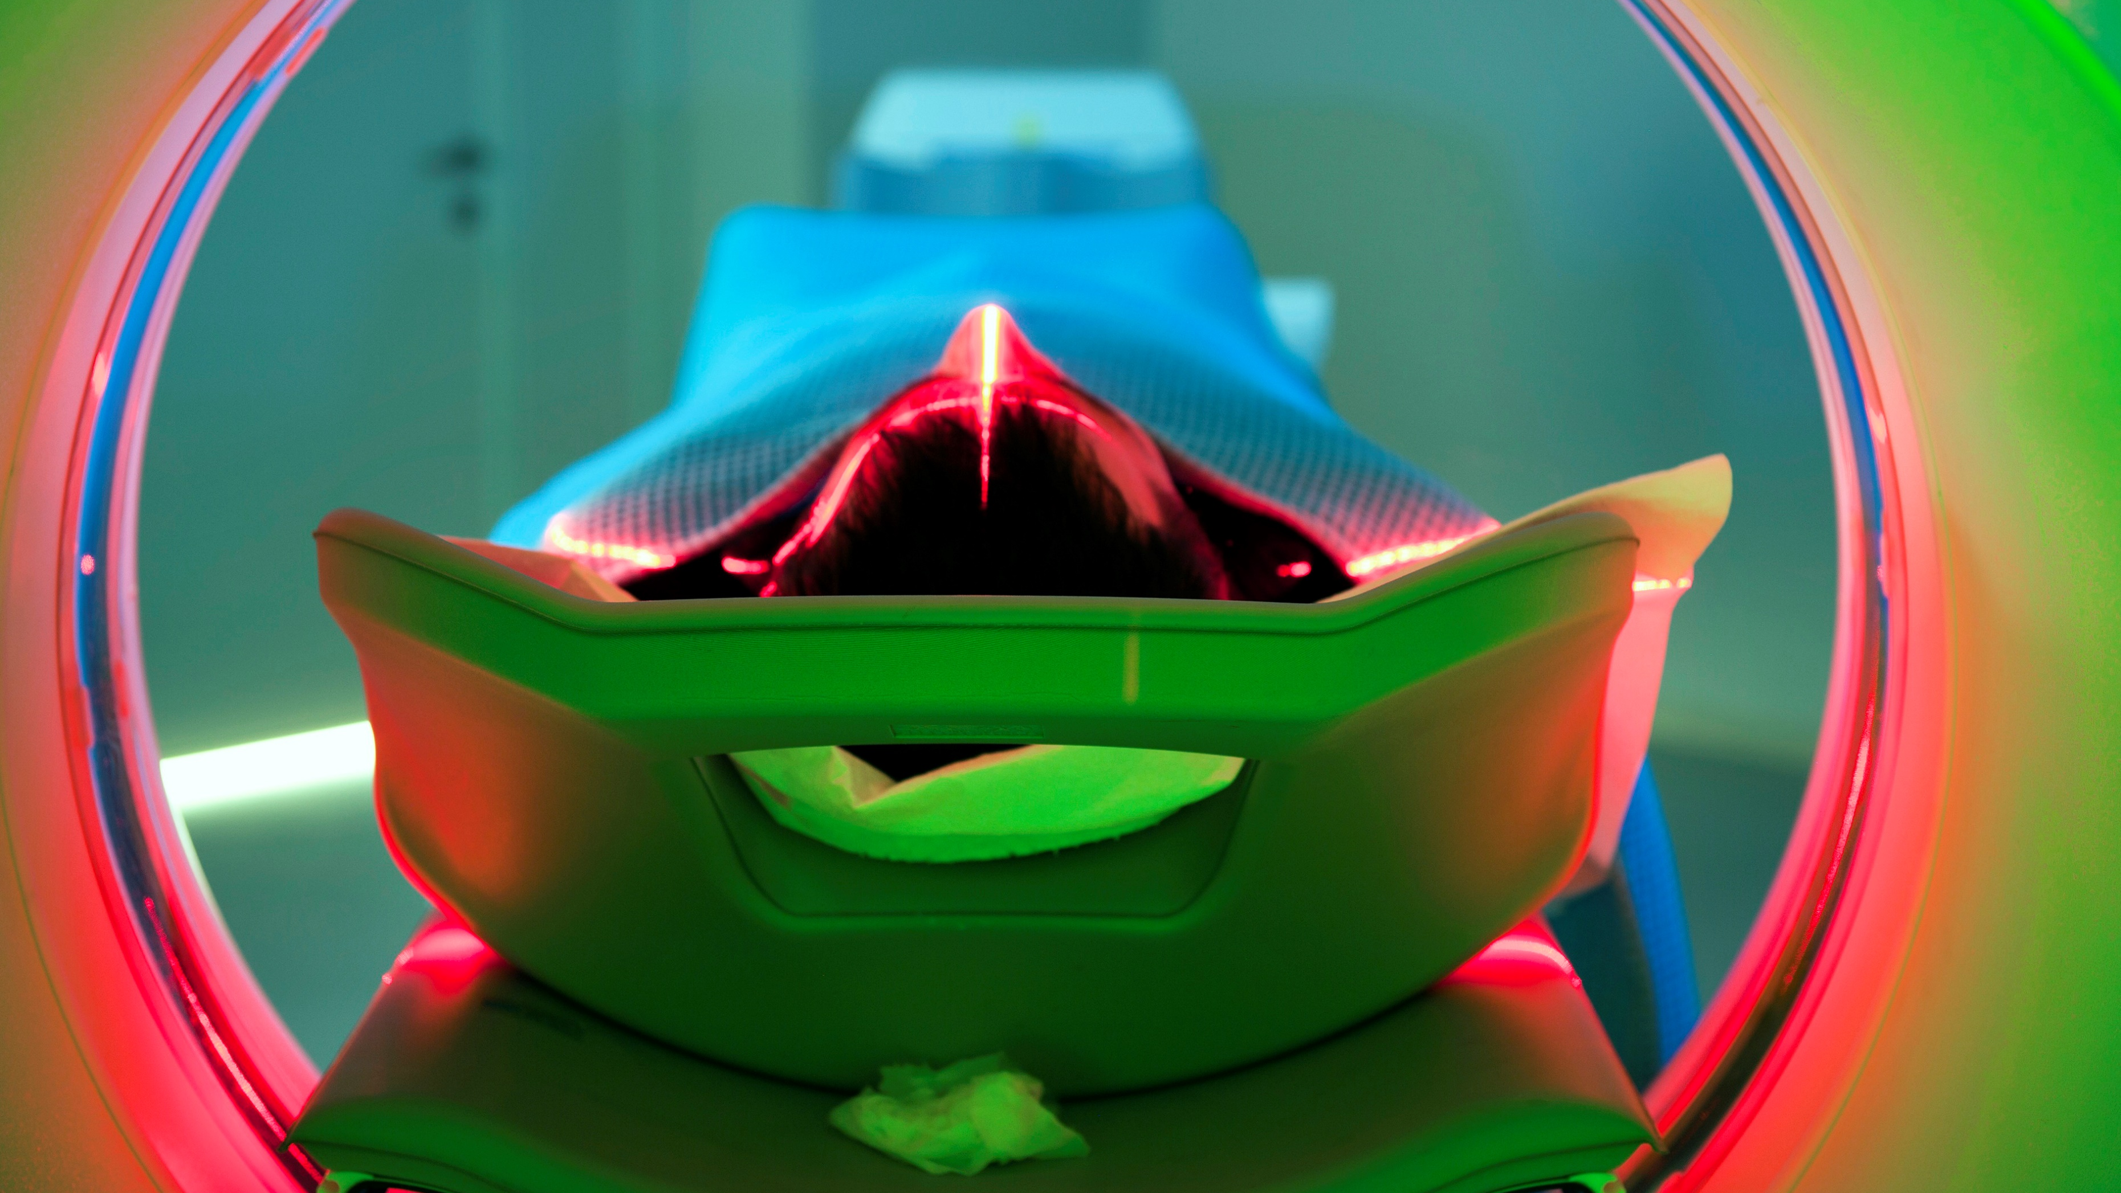
Introduction
Objective – To optimize patient waiting times (for radiology results) in an outpatient imaging service
Context- Large regional hospital system with 27 outpatient imaging locations evenly distributed in a geographic area
Motivation – To find optimal parameters that improve patient experience and operational efficiency

Slide 3

Patient Imaging Journey
Imagine experiencing persistent abdominal pain for a year. After a physical exam, your doctor suspects possible causes such as digestive issues, liver problems, or even neuropathic pain. To get a definitive diagnosis, an abdominal MRI with contrast is ordered. You spend days worrying and researching, but on the day of the appointment, you focus on getting through the process.
You arrive at the imaging office and face a lengthy registration process, filling out extensive paperwork and answering numerous questions about your medical history and insurance. Anxiety builds as you wait to be called for the scan.
When it's your turn, you change into a medical gown and have an IV inserted for the contrast agent. You lie still in the loud MRI machine, feeling every minute stretch into an eternity. The scan ends, but the waiting doesn't. The radiologist needs time to interpret the images and write the report. This could take anywhere from a few hours to several days. All the while, your anxiety about the results remains high.

Slide 4
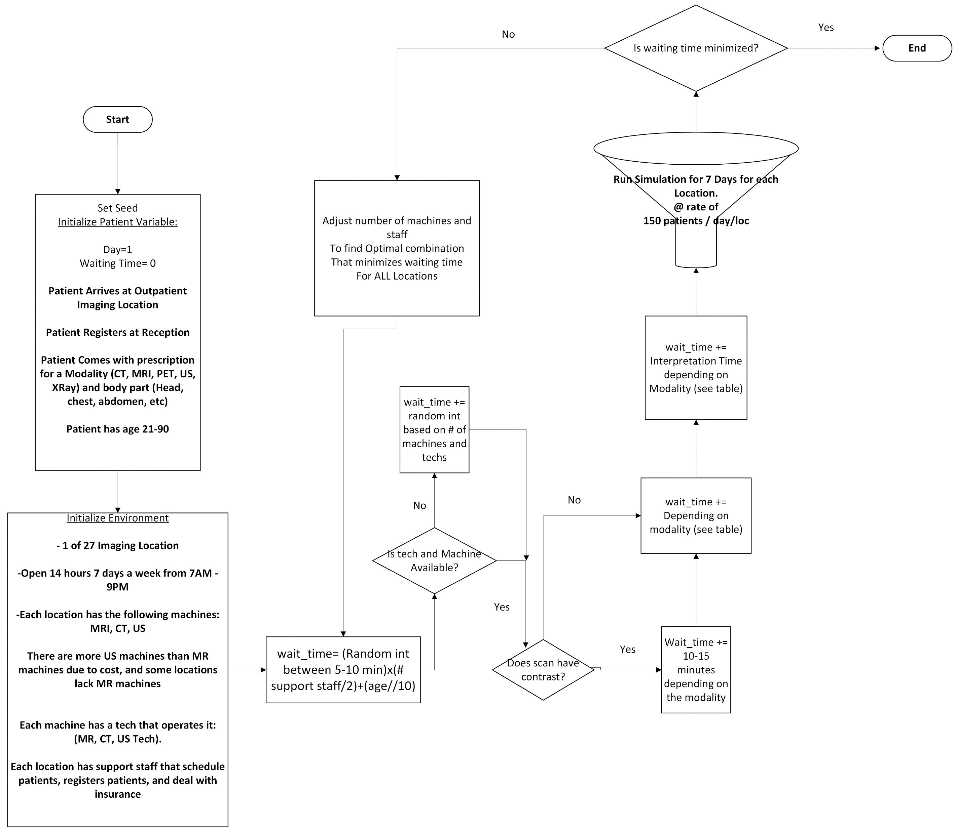
Simulating the Process

Slide 5
Established Acquisition duration of scans for simulation
Modality | Body Part | No Contrast (min) | With Contrast (min)
MRI | Brain | 45 | 60
MRI | Leg | 30 | 45
MRI | Abdomen | 40 | 55
MRI | Chest | 40 | 55
CT | Brain | 20 | 30
CT | Leg | 15 | 25
CT | Abdomen | 20 | 35
CT | Chest | 20 | 30
US | Head | 15 | -
US | Leg | 10 | -
US | Abdomen | 20 | -
US | Chest | 20 | -
US | Groin | 15 | -
X-ray | Head | 6 | -
X-ray | Leg | 5 | -
X-ray | Abdomen | 10 | -
X-ray | Chest | 8 | -
PET | Brain | 60 | -
PET | Abdomen | 55 | -

Slide 6
Established Interpretation Time for simulation
Modality | Body Part | Interpretation Time (min)
MRI | Brain | 39
MRI | Leg | 12
MRI | Abdomen | 46
MRI | Chest | 35
CT | Brain | 30
CT | Leg | 5
CT | Abdomen | 15
CT | Chest | 12
US | Head | 10
US | Leg | 18
US | Abdomen | 57
US | Chest | 40
US | Groin | 20
X-ray | Head | 20
X-ray | Leg | 22
X-ray | Abdomen | 25
X-ray | Chest | 30
PET | Brain | 60
PET | Abdomen | 55

Slide 7
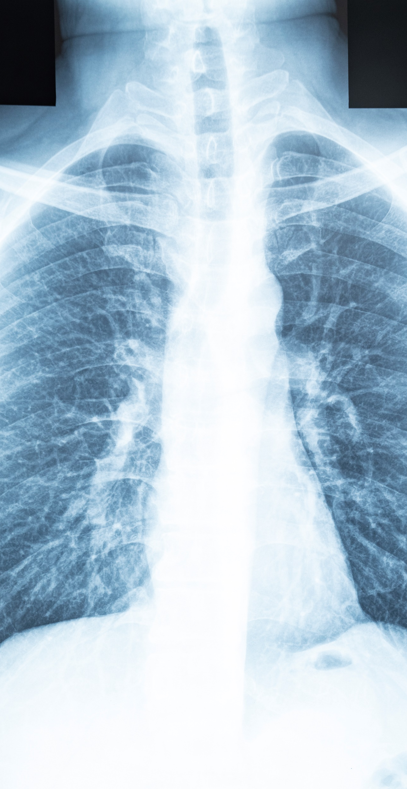
Running the Simulation
27 Imaging Location offices open for 14 hours a day
Receiving a pace of 150 px/day / location
Patients come in with a prescription with modality + body part
Time begins when patient arrives in office
Time ends when radiology report is finished

Slide 8
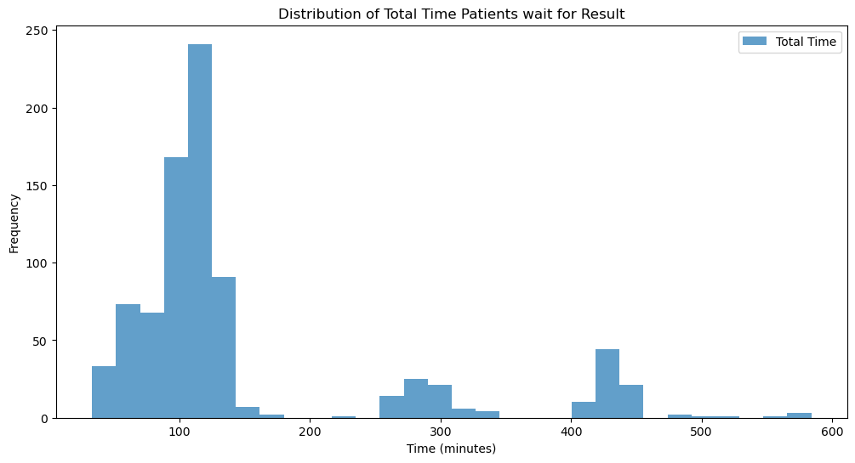
Simulation Results

Slide 9
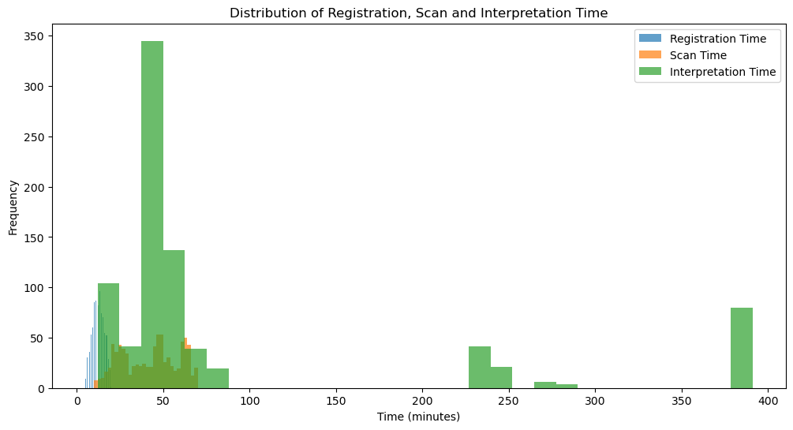
Simulation Results

Slide 10
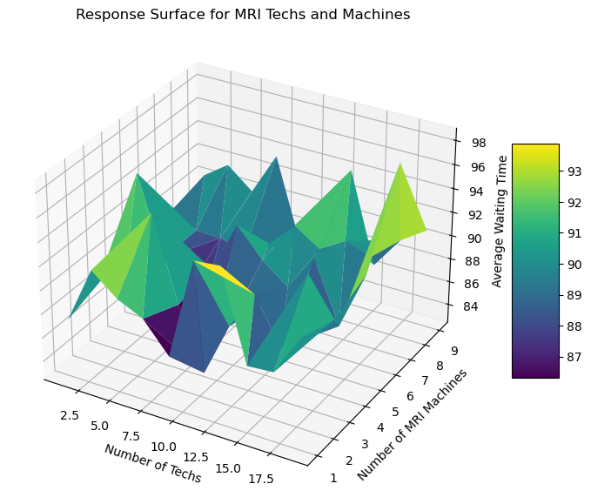
Optimizing Staffing and Available Machines
I ran the simulation to determine the optimal number of support staff per location and machines
Machines, like MRI are expensive, so places will have less of them compared to us.
Optimal number of MRI techs: 5
Optimal number of CT techs: 5
Optimal number of US techs: 5
Optimal number of support staff: 5
Optimal number of MRI machines: 2
Optimal number of CT machines: 3
Optimal number of US machines: 6

Slide 11
Simulation Validation
To validate, I compared my simulation to a M/M/1 model
M/M/1 Outperformed Simulation
M/M/1 model parameters should be adjusted in future to get more accurate model
Simulation performed worse and had a longer waiting time
Metric | Value
MSE (M/M/1) | 322.13
MSE (Simulation) | 26523.66
MAE (M/M/1) | 15.37
MAE (Simulation) | 106.99
Mean Waiting Time (M/M/1) | 75.49
Mean Waiting Time (Simulation) | 165.65

Slide 12
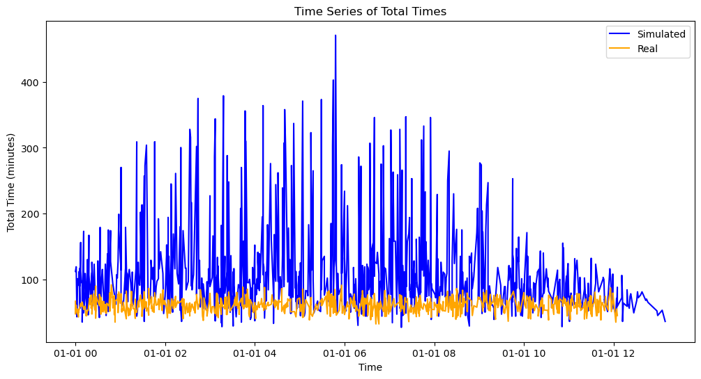
Comparing Model Time Series Plots
When comparing my simulated results to my ‘actual’ results, the mean and variability was greater in my simulated compared to my actual
My simulated has some characteristics of seasonality, although real might be too small to tell
Variability is greater in simulated

Slide 13
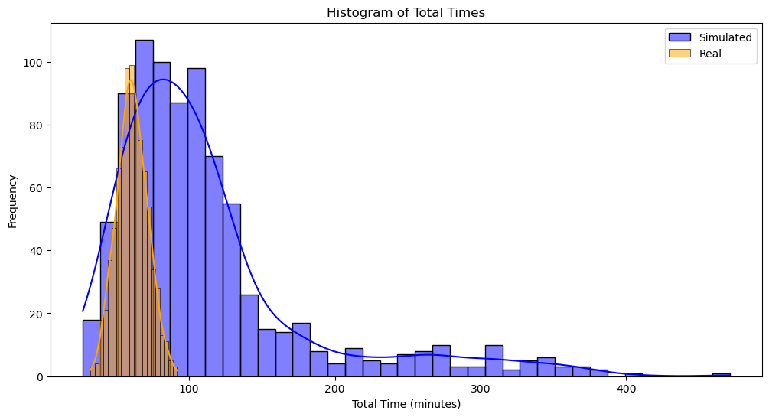
Comparing Model Distributions
Similar results when comparing the distribution of simulated and real data

Slide 14
Conclusion
Scenarios simulated for MRI, CT, US, X-ray, and PET scans.
Key parameters: Number of machines, technicians, and support staff.
Optimal Configuration:
MRI techs: 5
CT techs: 5
US techs: 5
Support staff: 5
Machines per location:
MRI: 2
CT: 3
US: 6
Results: Improved patient flow and reduced waiting times with optimized staffing and machine allocation. Simulation performed worse than the M/M/1 model, indicating areas for future improvement.

Slide 15

Conclusion
Validation:
Compared simulation with M/M/1 queuing model and generated "fake real" data
Metrics: Mean Squared Error (MSE), Mean Absolute Error (MAE)
Findings: M/M/1 model had lower MSE and MAE, suggesting it outperformed the simulation.
Future Work:
Fine-tuning M/M/1 model parameters for more accurate predictions.
Incorporating real patient data for validation.
Exploring advanced simulation techniques and machine learning models for better optimization.
Continuous iteration on model parameters to enhance accuracy and efficiency.

Slide 16
Works Cited
Poyiadji, N., Klochko, C., Laing, E., & Klein, K. (2023). Diagnostic imaging utilization in the emergency department: Recent trends in volume and radiology work relative value units. Journal of the American College of Radiology, 20(12), 1207-1214. https://doi.org/10.1016/j.jacr.2023.06.012
Duszak, R., Chatterjee, A. R., & Fields, B. K. K. (2020). Characteristics of COVID-19 community practice declines in noninvasive diagnostic imaging professional work. Journal of the American College of Radiology, 17(11), 1453-1459. https://doi.org/10.1016/j.jacr.2020.08.001
Downey, A. B. (2017). Modeling and simulation in Python (Version 3.4.3). Green Tea Press. https://greenteapress.com/ModSimPy3

